Slide 1
Doers Village & Innovation
Survey Results

Slide 2
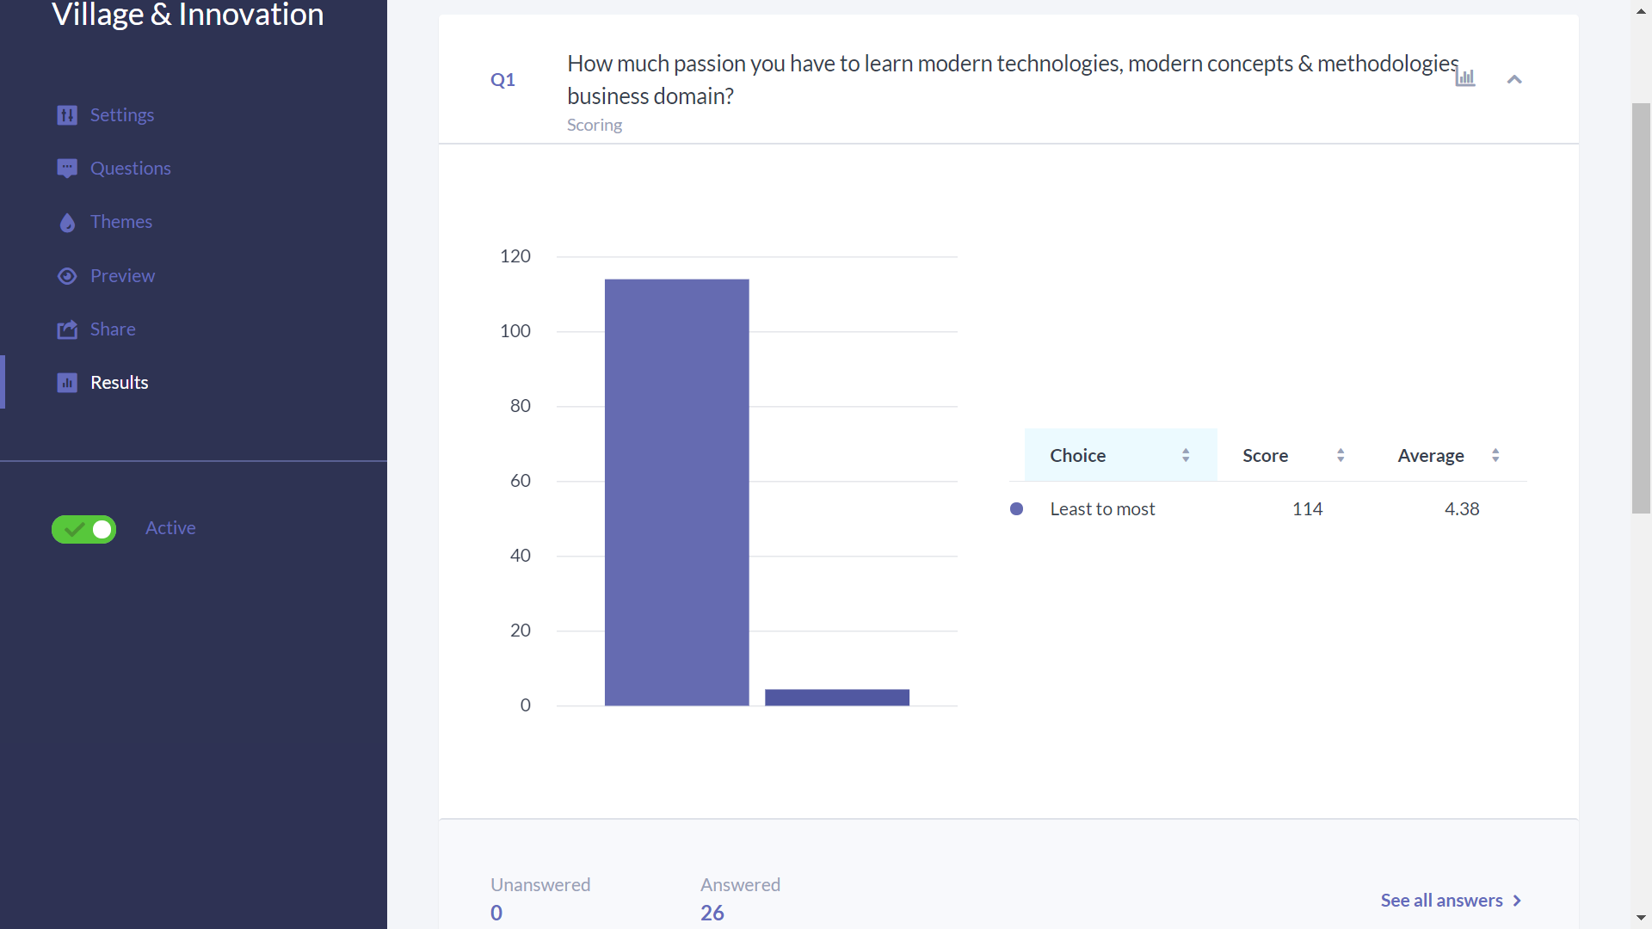
* This question has a range from 1 to 5

Slide 3
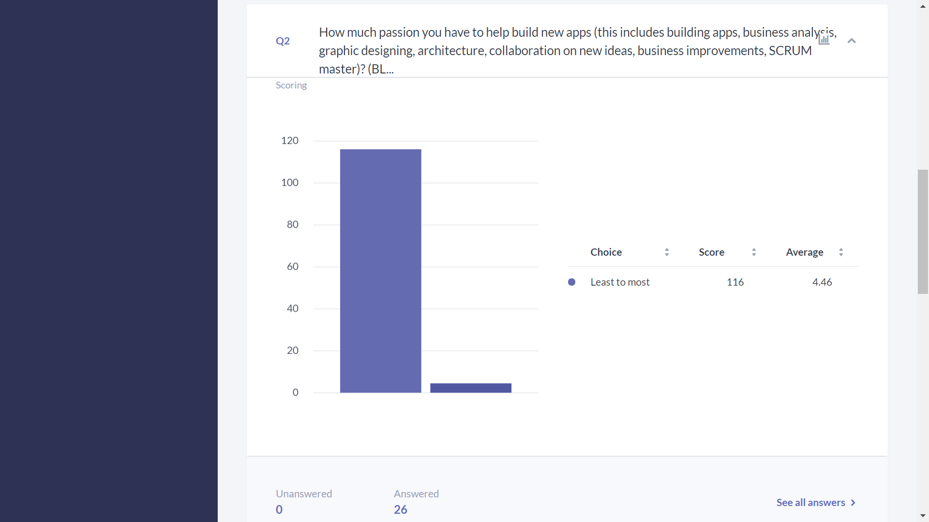
* This question has a range from 1 to 5

Slide 4
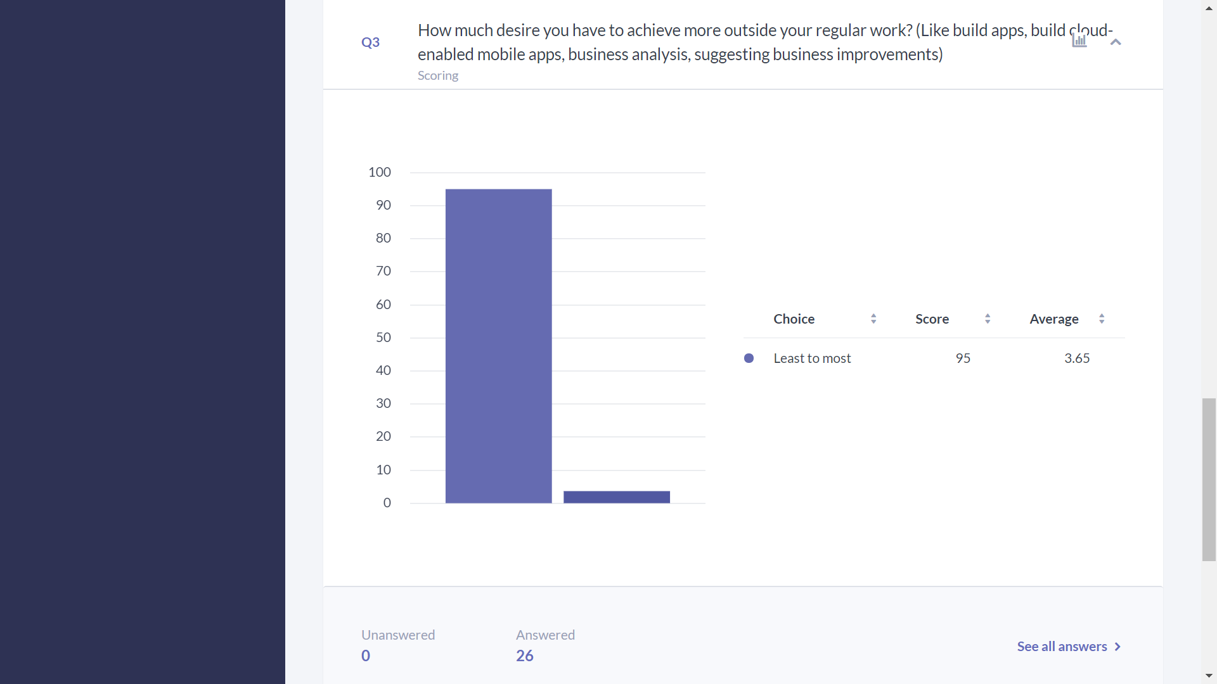
* This question has a range from 1 to 5

Slide 5
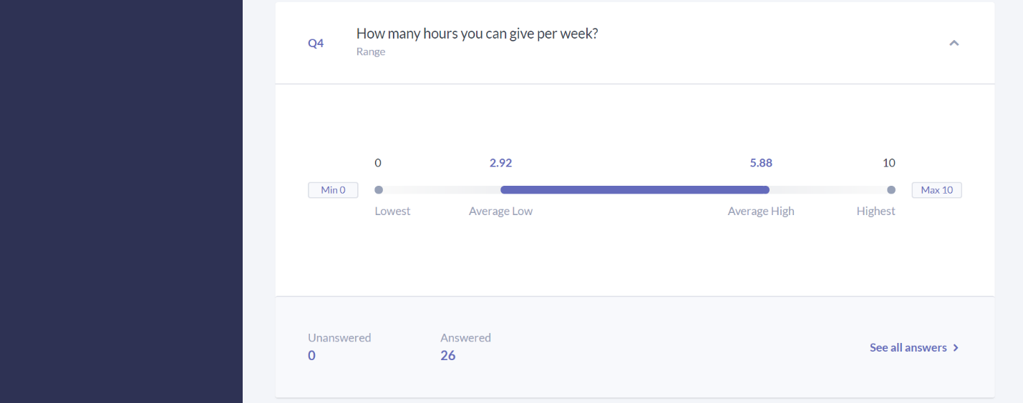
* This question has a range from 0 to 10

Slide 6
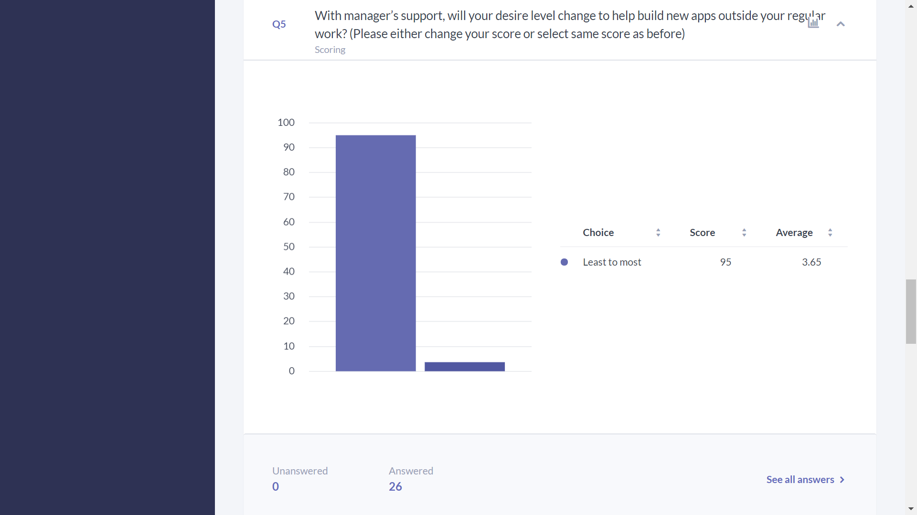
* This question has a range from 1 to 5

Slide 7
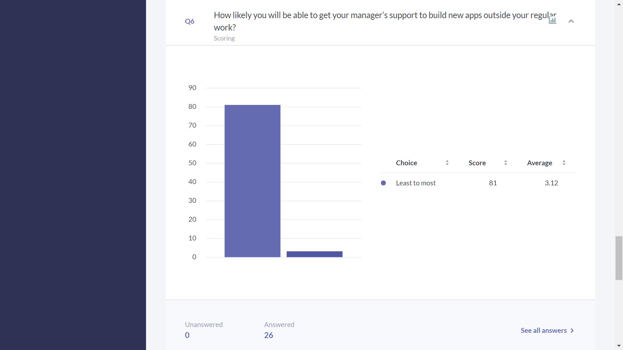
* This question has a range from 1 to 5

Slide 8
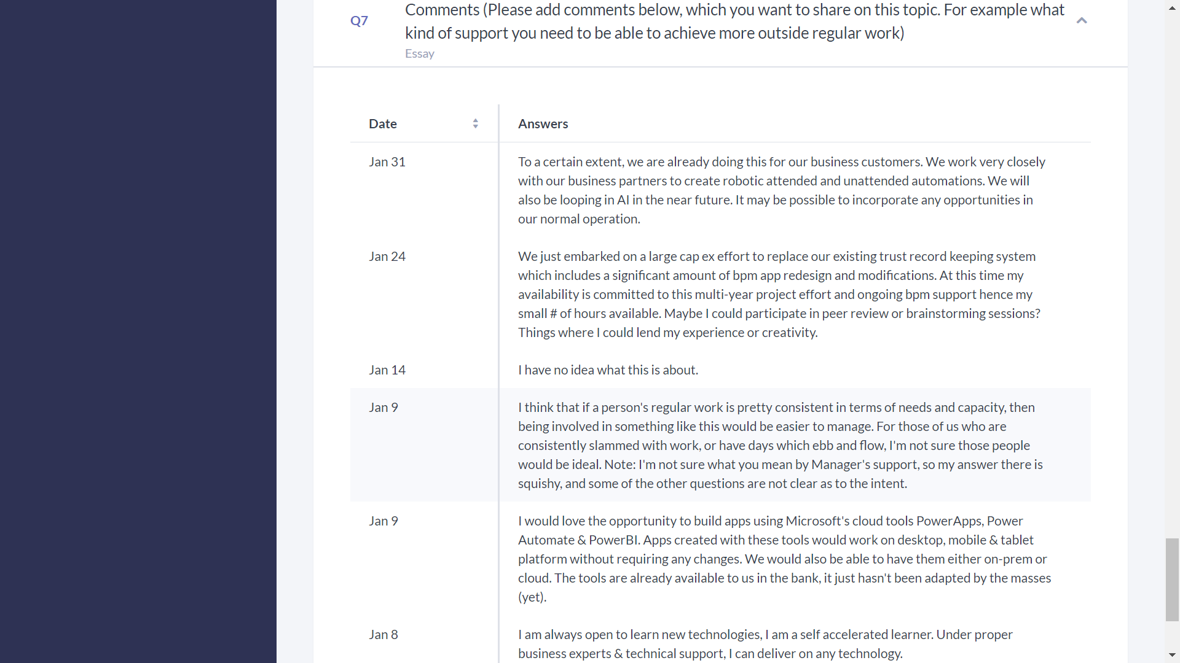
* User Comments.

